Slide 1
FINAL DATA SCIENCE CAPSTONE PROJECT
Predicting One-Year Diabetes Disease Progression
from Baseline Patient Measurements: a regression capstone with error analysis and risk insights
Lokesh Patwal | Data Science Intern, Yuva Intern | 01 October 2026 – 26 November 2026
Educational project on a historical research dataset – not a medical device.
Notes:
Introduce yourself and the project: you predicted how much a diabetes patient's disease will progress in one year, using ten measurements from the first visit. Say that it is an educational project on a public research dataset.

Slide 2
Introduction
▪ Why it matters Diabetes worsens quickly in some patients and slowly in others. Care teams have limited time and need to know whom to review first.
▪ Idea Use the measurements taken at the first visit to predict progression one year later.
▪ This project The complete workflow: problem, data, cleaning, exploration, models, evaluation, error analysis, insights and recommendations.
▪ Why this topic Three ideas were compared. Churn and attrition data could not be downloaded here, and invented data would make results meaningless. Real, published diabetes data suit every stage.
Project at a glance
▪ 442 patients
▪ 10 baseline predictors
▪ 1 numeric target
▪ 6 models + baseline
▪ 17 charts, 32 tests
▪ Fully reproducible (seed 42)
Final Data Science Capstone | Lokesh Patwal | Yuva Intern
2
Notes:
Explain why the problem matters. Clinics have limited appointments, so they need an objective way to decide whom to review first. Then explain that you applied the complete data-science workflow, and why this project was chosen: the usual churn and attrition datasets could not be downloaded here, and invented data would make every result meaningless.

Slide 3
Problem Statement
Using only measurements taken at the start (age, sex, BMI, blood pressure and six blood-serum values), can we predict how much a patient's disease will have progressed one year later, how reliable is the prediction, and which patient groups are at higher risk?
▪ Assumed stakeholders clinic manager, doctors and nurses who plan follow-up, a data team
▪ Motivation schedule follow-up, focus advice, decide what extra data to collect
▪ In scope one public dataset, regression models, evaluation, interpretation, risk segments
▪ Out of scope clinical validation, treatment decisions, causal claims, hospital deployment
Final Data Science Capstone | Lokesh Patwal | Yuva Intern
3
Notes:
State the question in one sentence and name the stakeholders. Stress that the stakeholders are assumed for this exercise, and that the project does not give medical advice. Mention the three parts of the question: how much progression, how reliable the prediction is, and which groups are at higher risk.

Slide 4
Objectives and Scope
▪ Define the capstone problem
▪ Collect and prepare data
▪ Apply statistics and machine learning
▪ Build and evaluate the solution
▪ Analyse results, errors and limitations
▪ Generate insights and recommendations
▪ Document and present
Success criteria (set in advance)
▪ Data quality fully documented
▪ RMSE at least 25 % below the baseline
▪ No sign of overfitting
▪ Errors analysed by patient group
▪ At least 3 recommendations linked to findings
Final Data Science Capstone | Lokesh Patwal | Yuva Intern
4
Notes:
Read the seven objectives briefly; they are the official internship objectives. Then explain that the success criteria were fixed before looking at the results, which stops results from being bent to fit afterwards. Say that all of them were met (slide 11 shows the evidence).

Slide 5
Dataset Overview
442
10 + 1
25 to 346
152.1
patients
predictors + target
range of the target
mean progression
Column | Meaning
age, sex | age in years; sex coded 1 / 2
bmi, bp | body mass index; average blood pressure
s1 to s4 | total cholesterol, LDL, HDL, cholesterol/HDL
s5, s6 | triglycerides marker (ltg); blood sugar (glu)
progression | TARGET: progression one year later
▪ Source Efron et al. (2004), via scikit-learn
▪ Access no download or account needed
▪ Limits 442 patients, one source, unknown selection, target has no unit
Final Data Science Capstone | Lokesh Patwal | Yuva Intern
5
Notes:
Name the dataset and its source. Explain the target variable and that all predictors are numeric. Be honest about the limits: only 442 patients, one source, unknown selection, no unit for the target, and undocumented sex codes. The data were read from the copy bundled with scikit-learn.

Slide 6
Methodology and Workflow
1 Define
problem
2 Load and
understand
3 Clean
the data
4 Split
80 / 20
5 Explore
(train only)
6 Engineer
features
7 Tune and
compare models
8 Test once,
analyse errors
▪ Split 353 training and 89 test patients, stratified by progression band, random_state = 42
▪ Tuning grid search, 5-fold cross-validation repeated twice, scored by RMSE (training set only)
▪ Rule fixed in advance among models within one standard error of the best, choose the simplest
Final Data Science Capstone | Lokesh Patwal | Yuva Intern
6
Notes:
Walk along the flow from left to right. The key design idea is the order of the steps: the test patients are put away before any exploration, so nothing learned from them can leak into the model. Model settings are tuned by cross-validation on the training set only.

Slide 7
Data Cleaning and Preprocessing
Check | Result | Decision
Missing values | 0 cells | No imputation needed (pipeline still safe for new data)
Duplicate rows | 0 | No patient counted twice
Data types / impossible values | all numeric; none impossible | sex recoded to a 0/1 variable (sex_2)
s4 against s1 / s3 | correlation 0.979 | kept as supplied (small gaps, likely rounding)
Outliers (1.5 x IQR) | 40 values in 31 patients | kept; test RMSE 52.1 without them against 52.0 with them
▪ No leakage the split comes first; scaling and imputation live inside the pipeline and are learned from training rows only
▪ Outcome no rows removed and no values changed
Final Data Science Capstone | Lokesh Patwal | Yuva Intern
7
Notes:
Go through the table quickly. The important message is that the checks were done and documented, not assumed: nothing was missing, nothing was duplicated, and the outliers were kept because they are real patients and the result does not change without them (RMSE 52.1 against 52.0).

Slide 8
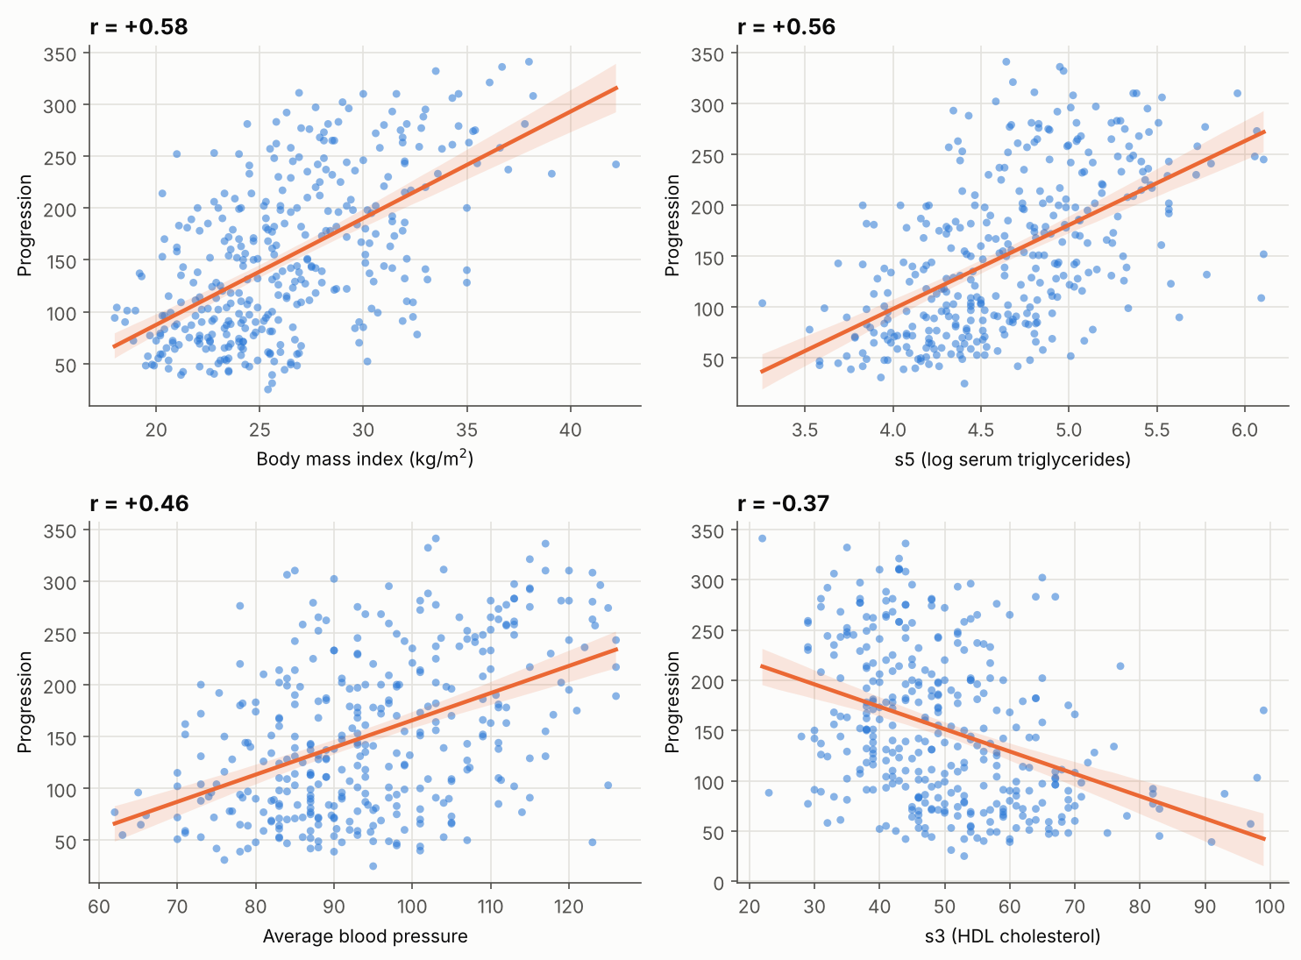
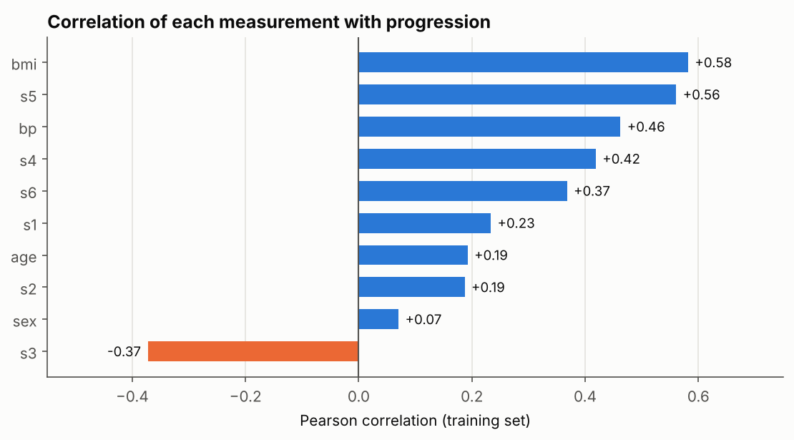
Exploratory Analysis: What Relates to Progression?
▪ Strongest BMI +0.58, s5 +0.56, blood pressure +0.46; HDL (s3) is protective (-0.37)
▪ Sex not significant (p = 0.26); target needs no transformation
▪ Association only other unmeasured factors may drive both the measurement and progression
Final Data Science Capstone | Lokesh Patwal | Yuva Intern
8
Notes:
Left chart: correlation of every predictor with progression. BMI, s5 (triglycerides marker) and blood pressure are strongest; HDL (s3) is negative, meaning protective. Right chart: the four most informative predictors against progression. Remind the audience that correlation is not causation, and note that sex is not significant.

Slide 9
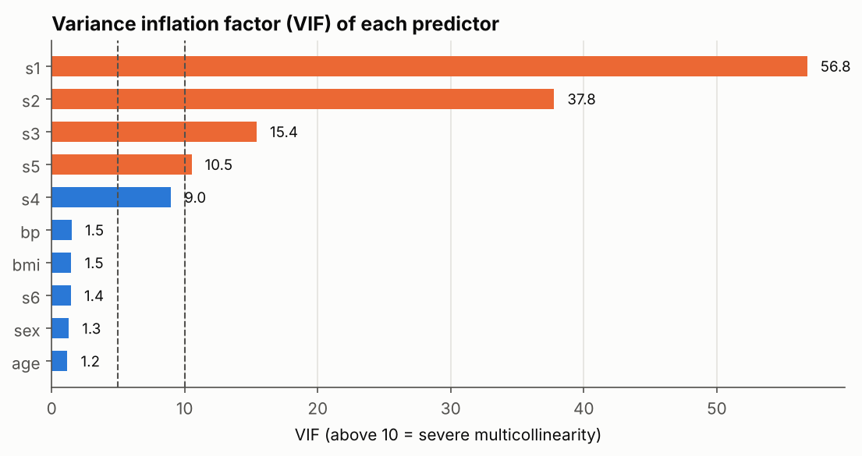
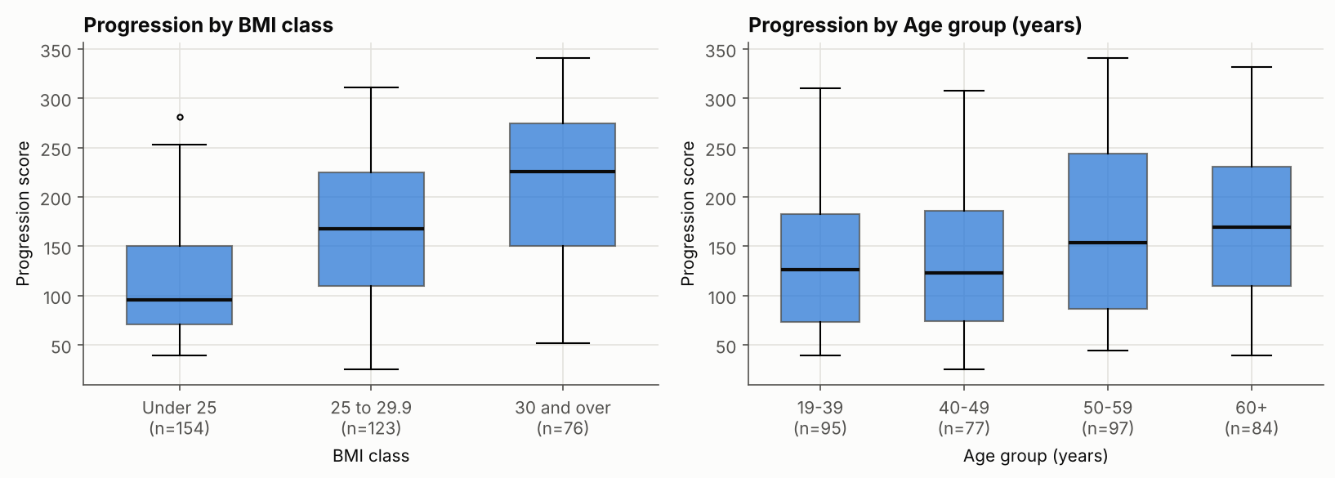
Feature Engineering and Overlapping Measurements
▪ BMI classes mean progression 111, 165 and 214 (p = 1e-20)
▪ Did they help? No: RMSE changed by +0.35 (Ridge), standard error about 1.9
▪ Overlap VIF up to 57 for s1: individual cholesterol coefficients cannot be interpreted one by one
Final Data Science Capstone | Lokesh Patwal | Yuva Intern
9
Notes:
Left: progression rises steeply across BMI classes and mildly with age. Right: the variance inflation factor shows that the cholesterol measurements overlap heavily. Key honest result: engineered features were tested and did not improve prediction, so they were not used in the final models. They are still useful to explain results.

Slide 10
Data Science Techniques and Model Development
Model | Why it was chosen | CV RMSE
Baseline (mean) | minimum standard | 76.9
Linear Regression (selected) | simple, transparent benchmark | 55.2
Ridge | stable when predictors overlap | 55.0
Lasso | can switch weak predictors off | 55.0
Decision Tree | readable rules, unstable | 61.7
Random Forest | many trees, non-linear effects | 56.1
Gradient Boosting | trees correcting trees | 56.2
Selection (one-standard-error rule)
▪ Lowest CV RMSE: Ridge (55.01)
▪ Limit: 56.82
▪ 5 models fall inside the limit
▪ Simplest = Linear Regression
▪ Test set not used for the choice
Flexible models gave no real advantage: the relationships are nearly straight, and the limit is set by the information in the data.
Final Data Science Capstone | Lokesh Patwal | Yuva Intern
10
Notes:
Seven approaches were compared, from the baseline to tree ensembles. All are pipelines, tuned on the training set only. Explain the selection rule: five models are within one standard error of each other, so the simplest, Linear Regression, wins. XGBoost was not available here; scikit-learn Gradient Boosting is in the same family.

Slide 11
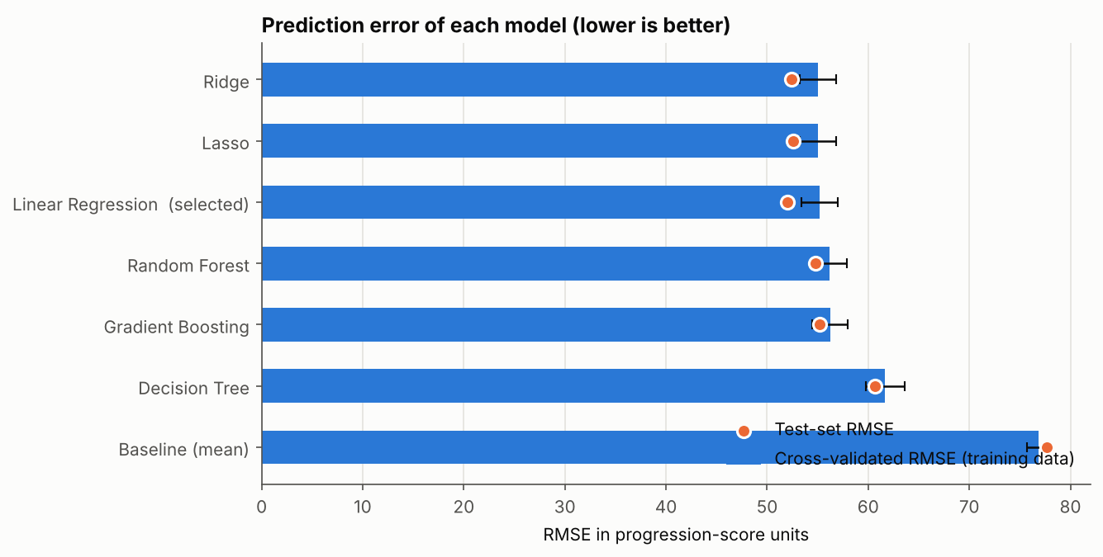
Model Evaluation and Results
52.0
41.7
test RMSE (baseline 77.7)
test MAE (points)
0.55
33 %
R-squared (0.39 to 0.67)
lower RMSE than baseline
▪ No overfitting training 53.9, cross-validated 55.2, test 52.0
▪ Trees overfit training gaps of 12 and 9 points
All success criteria were met (see the report, Table 10.3).
Final Data Science Capstone | Lokesh Patwal | Yuva Intern
11
Notes:
Left: cross-validated comparison of all models. Right: headline results on the 89 unseen patients. The model cuts the error by a third compared with predicting the average. Training, cross-validation and test errors are close, so there is no overfitting. Point out the wide interval for R-squared: the test set is small.

Slide 12
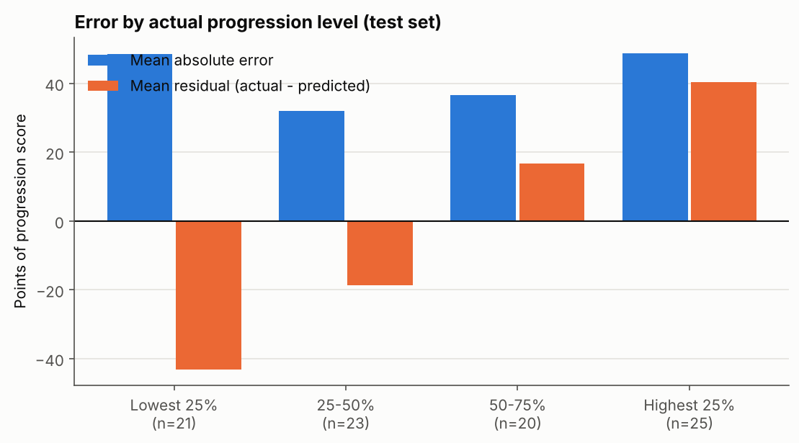
Error Analysis: Where Does the Model Go Wrong?
▪ Typical error about 42 points; 42 % within 25 points, 65 % within 50
▪ Regression to the middle lowest quarter over-predicted by 43, highest under-predicted by 40
▪ Residuals no bias, consistent with a normal distribution
▪ Biggest misses all above 90 points, no common profile: factors not in the data
▪ Learning curve flat: more of the same rows adds little, better measurements would help
Final Data Science Capstone | Lokesh Patwal | Yuva Intern
12
Notes:
The model is unbiased overall but squeezes predictions toward the average: the lowest actual scores are over-predicted and the highest are under-predicted. So the score should be used to rank patients, and the worst cases will tend to be worse than predicted. The biggest misses have no common profile, which points to missing information.

Slide 13
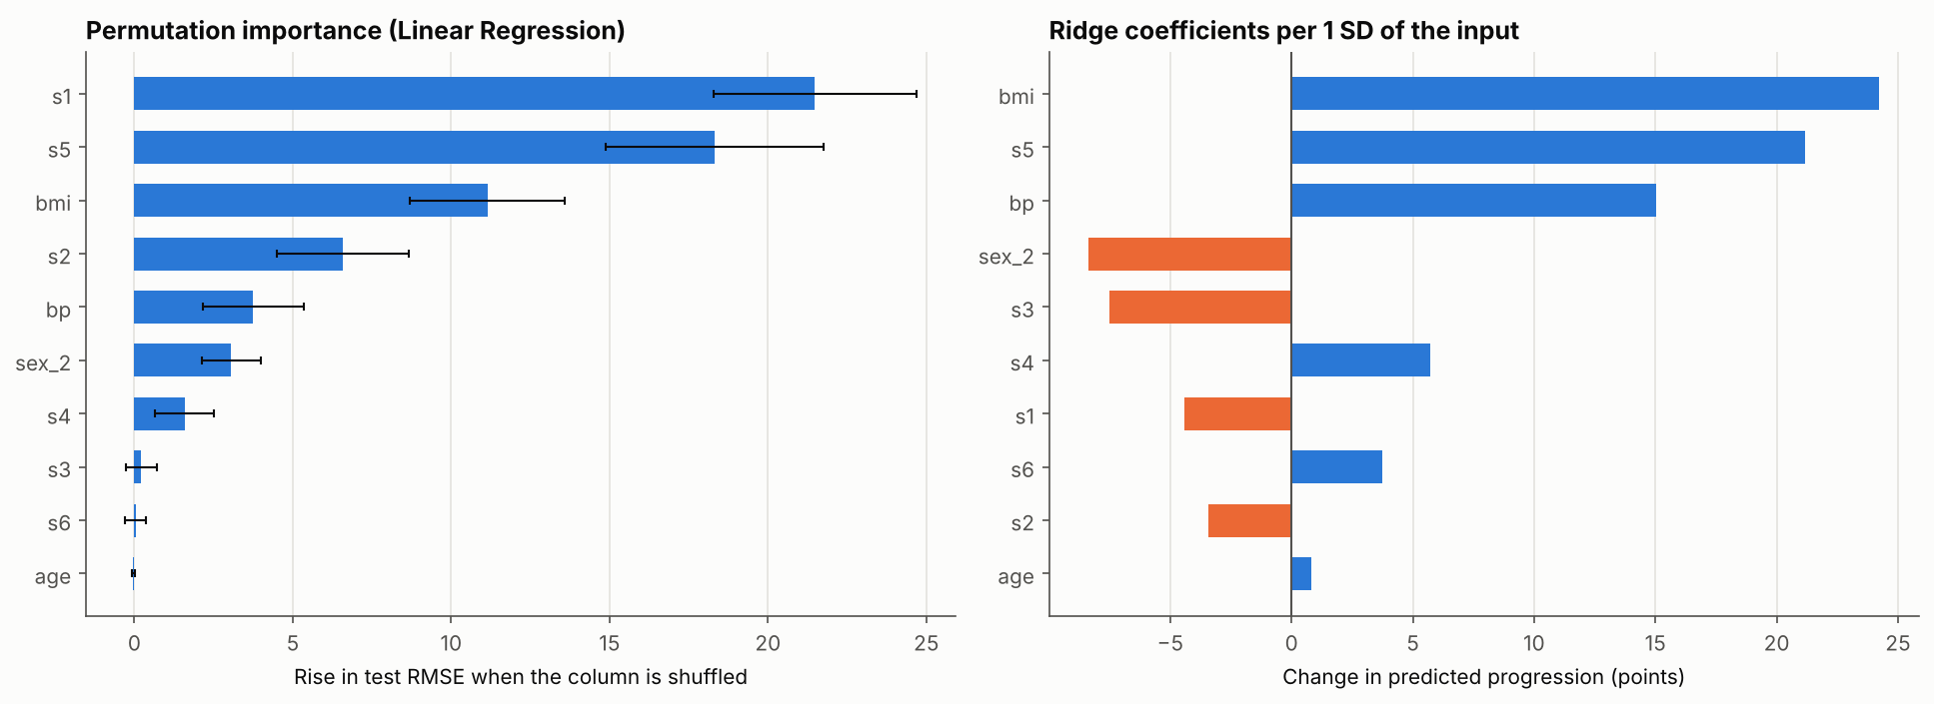
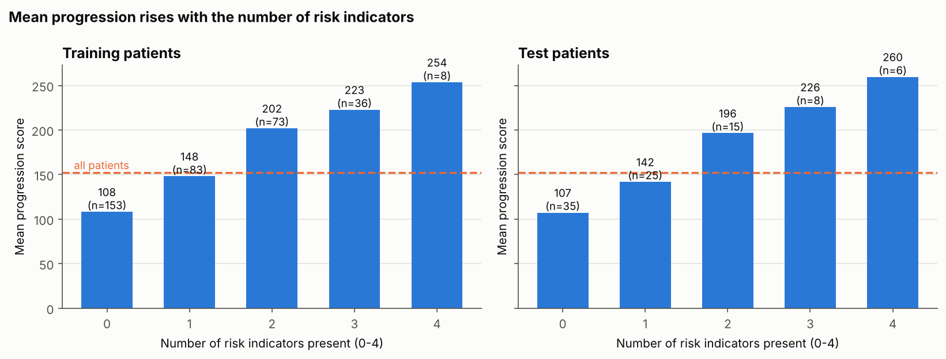
Key Insights
▪ Top drivers BMI, serum triglycerides (s5), blood pressure; then the cholesterol group and sex (after adjustment)
▪ Risk accumulates mean progression 108 with no indicator, 254 with all four; ROC-AUC for fast progressors 0.92
Final Data Science Capstone | Lokesh Patwal | Yuva Intern
13
Notes:
Left: what the model relies on. BMI, s5 and blood pressure are the dependable drivers; the cholesterol group matters as a whole but cannot be separated into single measurements. Right: counting four simple risk indicators separates patients well, and the same pattern holds in the unseen test patients. Repeat that these are associations, not causes.

Slide 14
Business Recommendations
ID | Proposed action | Supported by | Priority | KPI
R1 | Use the model score (or the 4-indicator count) as a triage ranking | AUC 0.92; steady rise with indicators | High | Share of fast progressors reviewed early
R2 | Offer weight-management support first to BMI 30 and over | 55 % fast progressors vs 6 % under 25 | High | Change in BMI and progression at 12 months
R3 | Review lipid and blood-pressure results together; flag 2+ indicators | s5 and bp are robust drivers | Medium | 2+ indicator patients with a plan
R4 | Choose the alert cut-off from clinic capacity | recall rises as precision falls | Medium | Recall and precision on live data
R5 | Show a ranking or range, not an exact score | MAE about 42; extremes compressed | Medium | Calibration in new patients
R6 | Collect richer data before a more complex model | half the variation unexplained | Medium | CV RMSE after adding variables
Proposals for a hypothetical clinic: association is not causation; each needs a pilot or comparison group and clinical review.
Final Data Science Capstone | Lokesh Patwal | Yuva Intern
14
Notes:
Every recommendation is tied to a finding and has a KPI and a way to test it. They are proposals for a hypothetical clinic and need clinical review. No financial return is claimed, because the data cannot support one. Priorities: R1 and R2 are high; the others are medium.

Slide 15
Limitations, Future Scope and Conclusion
Limitations
Future scope
▪ Small, single-source data (442 patients)
▪ No external validation; test R-squared interval 0.39 to 0.67
▪ About half the variation unexplained
▪ Overlapping cholesterol measurements
▪ Association, not causation; not a clinical tool
▪ Validate on another patient group or period
▪ Richer data: repeat measurements, lifestyle, medication
▪ Interactions, splines, prediction intervals, SHAP
▪ Fairness checks once sex coding is documented
▪ A simple risk dashboard with alert threshold
Conclusion: Linear Regression cut the error by 33 % without overfitting (R-squared 0.55). It ranks patients well; better data is the next step. Thank you | Questions?
Final Data Science Capstone | Lokesh Patwal | Yuva Intern
15
Notes:
Finish with the honest limits, then the conclusion in two sentences: a simple model beat the baseline by a third without overfitting, and the most valuable next step is better data. Invite questions. Remind the examiners that every number comes from the executed notebook (results/key_results.json).

